Slide 1
Library Management System
A Library software using a server-side database MySQL.

Slide 2
Motivation :
Due to current circumstances the management of the workload has been shifted to online platforms.
It is manually impossible to perform the library procedures so with the help of SQL database server the logs and entries and maintained.
It is easy to access at any given point of time or place.
Also it reduces the staff required for each task. Less time consuming.

Slide 3

Introduction
WHAT IS LIBRARY MANAGEMENT SOFTWARE?
1. LMS helps in maintaining data of books issued to learners and books available in library.
2. Helps libraries to keep track of the books and their checkouts, as well
as members profiles and subscription.
We’ll be creating a Library Software using a server-side
database and Tkinter, which can do all sorts of things.

Slide 4
Features of LMS
Customize login for the students, employees, registration page for first time use.
Enumeration competency of the regular newspaper, journals and magazines.
Flawless issuance and returning of books.
Simple to manage accounts in the library management software for the academic compliances.
Fetching record of the issued or unissued materials in the library.

Slide 5
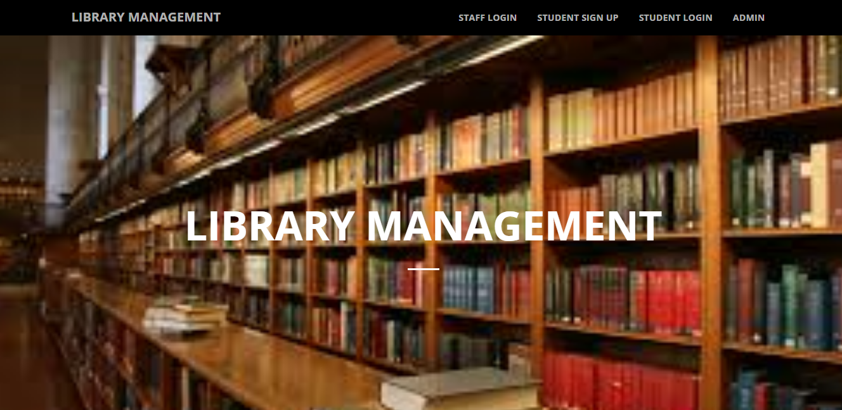
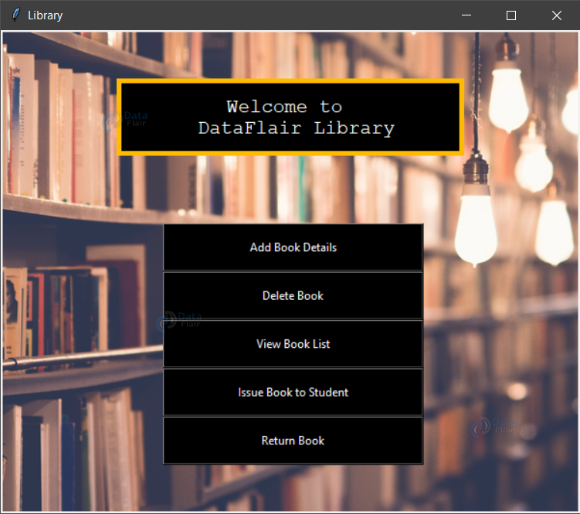
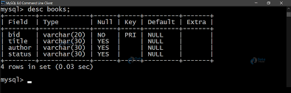
Objectives
To handle the entire activity of a library.
The software keeps track of all the
information about the books and their complete details.
The system contains database where all the
Information will
be stored safely.

Slide 6
Entities,Attributes and relations.
Entities and their attributes:
Relations between Entities:
Book Entity: BookID, Book Name, Author, Subject, Status.
Employee Entity: Emp_ID, Name, password, Salary, Date of joining (doj), Department.
Student Entity: Batch, password, Name, Roll no, semester, department.
Issue Entity: Issueid , Bookid , issueto, issued by.
A student can issue N books but one book can be issued by only one student. The relationship is 1:N.
Employee keeps track of students. The relationship is M:N.
Employee maintains multiple Books. The relationship between employee and book 1:N.
Authentication system provides login to multiple employee and student .Both their relation is 1:N.

Slide 7
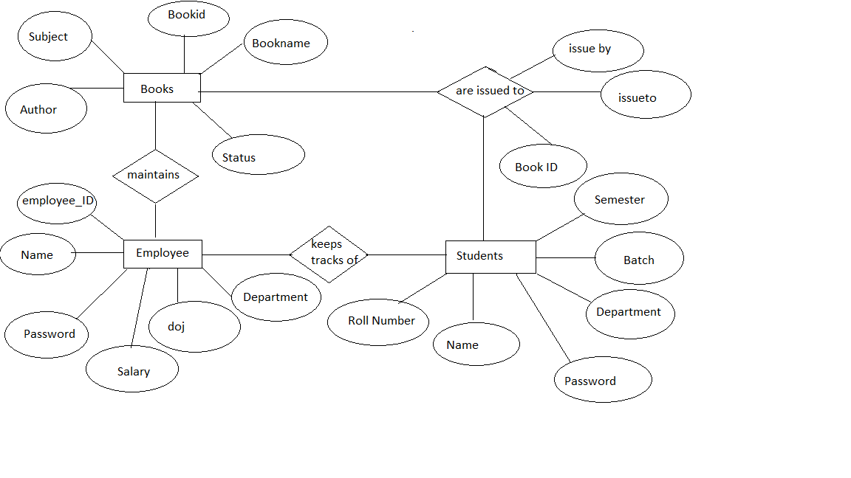
ER Diagram

Slide 8
Advantages
1. Simple & Easy to Use
2. Increased Library Engagement
3. Secure, Scalable & Reliable
4. Mobile Access
5. Dynamic Reports
6. Error-free
7. Innovation
8. Fully Customizable

Slide 9
Disadvantages
Expensive.
Risk of computer virus.
Requires manual action to perform operations.

Slide 10
Conclusion
SQL database management application which is very well used in the modern world in organising and manipulation a database.
Though SQL does not have the GUI we have integrated with python to manage the database comfortably.
Depending on the user or users, if an organisation has multiple users then they should go for SQL server based application.
This project shows how to create tables in SQL and how to create simple data manipulation language and data definition language with how to execute them.

